Slide 1
Digital Portfolio
STUDENT NAME: R.Kaviya
REGISTER NO AND NMID: 2426J1446 & as2426j1446
DEPARTMENT: B.Sc IT
COLLEGE: Cheran Arts Science College

Slide 2
PROJECT TITLE
💸Smart expense spillter

Slide 3


AGENDA
Problem Statement
Project Overview
End Users
Tools and Technologies
Portfolio design and Layout
Features and Functionality
Results and Screenshots
Conclusion
Github Link
3/21/2024 Annual Review

Slide 4

PROBLEM STATEMENT
🎯 Problem Statement
Managing shared expenses manually often leads to confusion, miscommunication, and awkward conversations. This app solves that by:
- Automating expense splitting
- Providing clear payment reminders
- Categorizing spending for better financial awareness

Slide 5

PROJECT OVERVIEW
🧾 Project Overview
Smart Expense Splitter is a responsive web application built with HTML, CSS, and JavaScript that helps groups fairly split shared expenses. It includes features like category tracking, payment reminders, and real-time balance calculations, making it ideal for roommates, travel groups, or event organizers.

Slide 6

WHO ARE THE END USERS?
- 🏠 Roommates
- ✈ Travel groups
- 🎉 Event organizers
- 👨‍👩‍👧‍👦 Families
- 👥 Small teams or startups
- 🎓 College students

Slide 7

TOOLS AND TECHNIQUES
Technology | Purpose
HTML | Structure and layout
CSS | Styling and responsive design
JavaScript | Logic, interactivity, data flow
LocalStorage | Persistent data without backend

Slide 8
POTFOLIO DESIGN AND LAYOUT
🧾 Portfolio Design & Layout: Smart Expense Splitter
🏷 Project Title
💸 Smart Expense Splitter
A simple and intuitive web app to split group expenses fairly.
‹#›

Slide 9
FEATURES AND FUNCTIONALITY
Feature | Description
👥 Add Participants | Dynamically add people involved in shared expenses
💰 Log Expenses | Record who paid, how much, and for what category
📊 Balance Calculation | Automatically calculates who owes or is owed
🔔 Payment Reminders | Displays actionable reminders for settling debts
🧾 Category Breakdown | Tracks spending across categories like Food, Travel, Utilities, etc.
📱 Responsive Design | Works seamlessly on mobile, tablet, and desktop

Slide 10
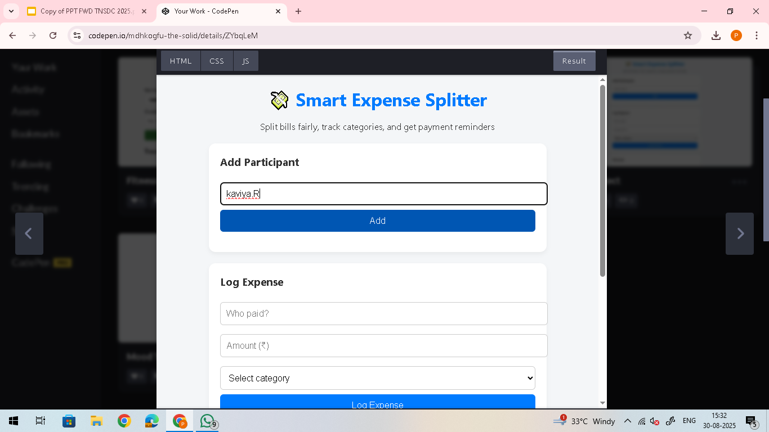

RESULTS AND SCREENSHOTS
3/21/2024 Annual Review
‹#›

Slide 11
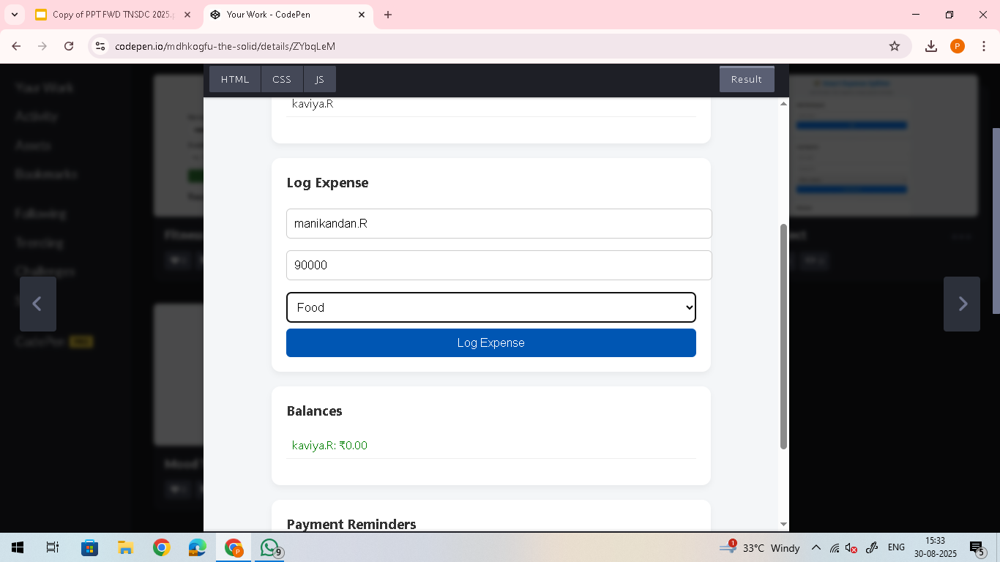
RESULTS AND SCREENSHOTS
3/21/2024 Annual Review
‹#›

Slide 12
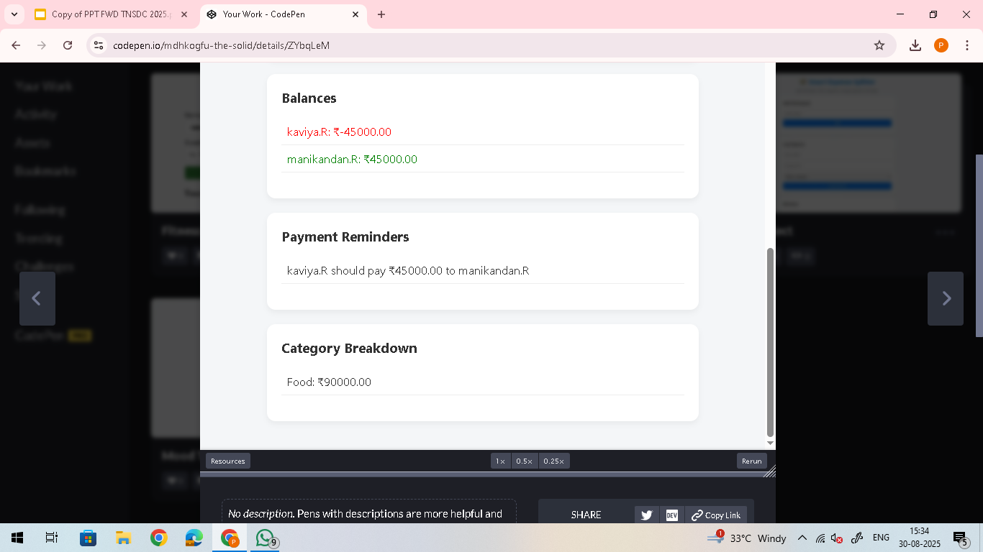
RESULTS AND SCREENSHOTS
3/21/2024 Annual Review
‹#›

Slide 13
CONCLUSION
The Smart Expense Splitter is a practical and user-friendly web application designed to simplify shared financial management. By combining clean design with powerful features like real-time balance tracking, category breakdowns, and payment reminders, it empowers users to handle group expenses transparently and efficiently. Whether for roommates, travel buddies, or event organizers, this tool brings clarity and fairness to everyday spending.
This project demonstrates strong front-end development skills, thoughtful UX design, and a clear understanding of real-world problems — making it a valuable addition to any digital portfolio.
‹#›

